Slide 1

COVID TRACKER APP
CREATED BY WAP Team

Slide 2
Team Members
Rayan Treebhowon N01226282
Tsidkeenu Aznar N01180428
Satyam Dalvadi N01333116
Jagminder Sembi N01300801

Slide 3
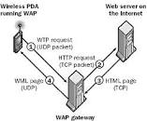
WAP Team
We are Team W.A.P.
It stands for Wireless Application Protocol (W.A.P)
It is the technical standard for accessing information through mobile wireless networks and API

Slide 4
Functionality
Our application retrieves live data from WHO(World Health Organization) using their APIs.
It is then displayed to the user as live data and is updated every time the user refreshes the page or starts the application.
Our application will mainly focus on the main page as worldwide date.
And then it will be broken down as for the user to see countries around the world.
Live Data is stored in a table view and in the Saved Data tab.
Our application supports both English and French.

Slide 5

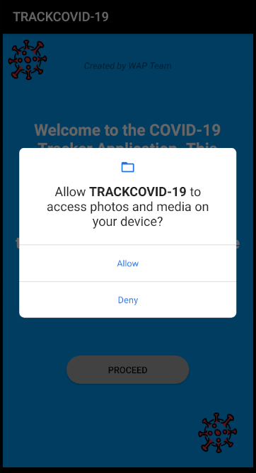
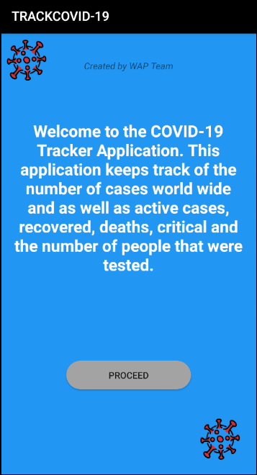
User Interface:
Application Goal: During this pandemic we saw people with lack of information about COVID-19 and their statistics. So basically we decided to build an application to keep people updated on the world’s statistics and cases live.
User Permission: One time user permission when installing the application will be asked to access the photos and media of the device.
Welcome Screen: Welcome screen will explains the user the use of our application.

Slide 6
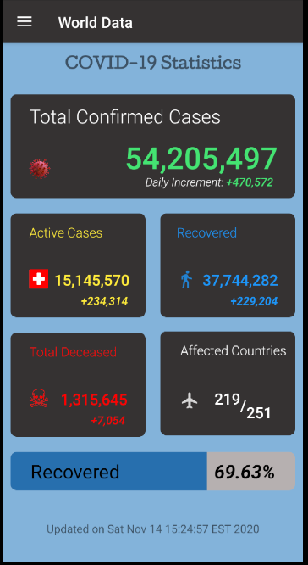
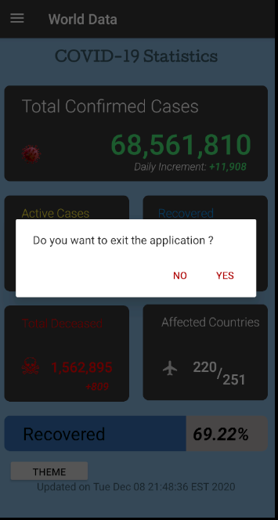
User Interface
Main Screen: The main screen will display the worldwide statistics as you can see on the screenshot. It is indeed live data retrieved from WHO(World Health Organization API).
onBackPress: OnBackPress it will show a user and alert Dialog box if whether they want to exit the application or not.

Slide 7
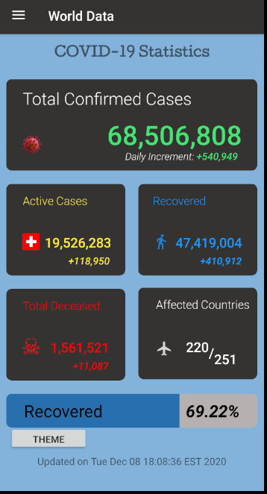
Background Change
User will be able to change the color of the background using the theme button throughout all screens to make it easier for them. (Button will be available on all screens)
Colors Available: RED, BLUE, GRAY, GREEN, YELLOW, CYAN

Slide 8
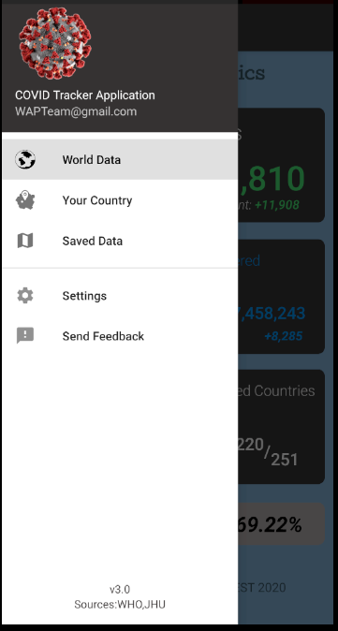
User Interface:
Navigation: User will be able to decide where they wish to proceed next. They have the option between World Data, to see each affected countries and the Saved Data in a table view, also be able to use settings and eventually send us Feedback to improve or fix bugs in our application.
Tabs Functionality.

Slide 9
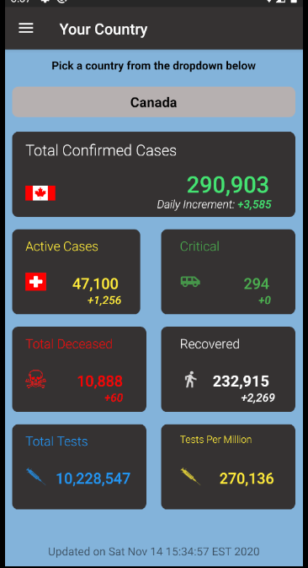
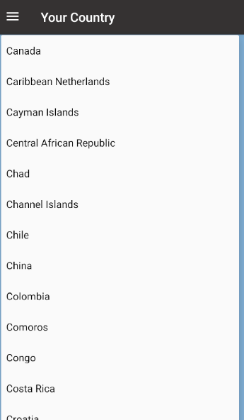
User Interface:
Your Country Screen: On this screen individual live data will be displayed for the selected countries worldwide.
By pressing on the drop down the list of all the countries will be displayed in alphabetical order for the user to choose the country they wish to see the data

Slide 10
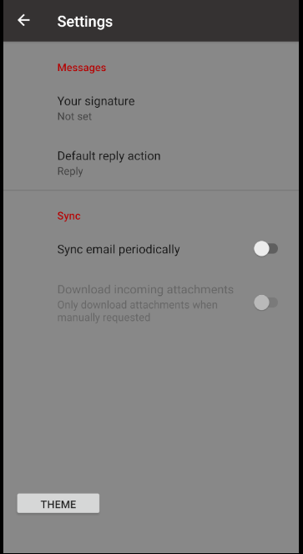
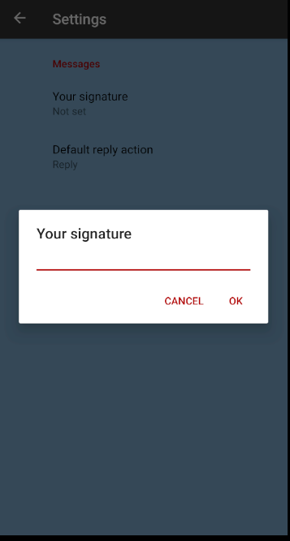
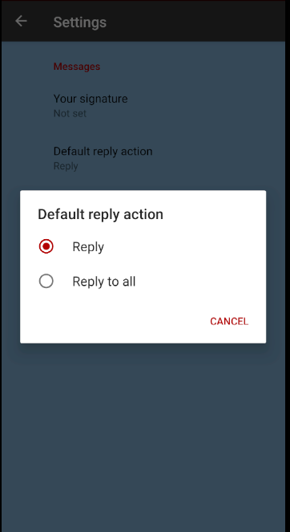
User Interface:
Settings Screen: On this screen user will be able to save their signature for their email and set their reply action if it is either reply to only on or reply to all.
User’s preferences will be saved even if the application is closed or cleared.

Slide 11
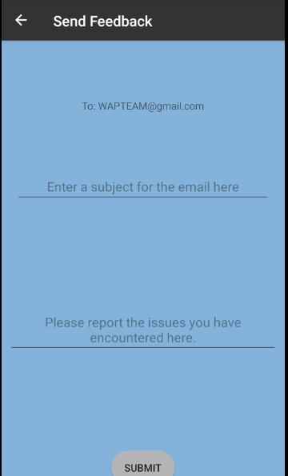
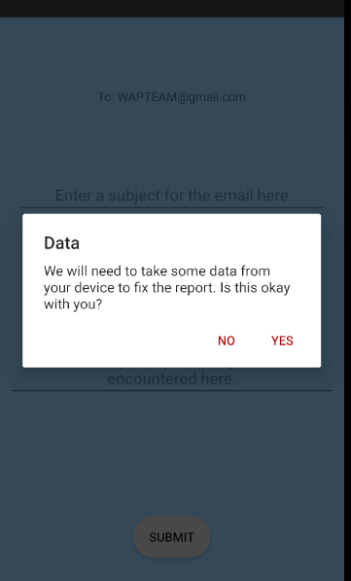
User Interface
Send FeedBack Screen: On this screen user will be able to type in any requests about the issues they encountered and improvements they wish to see in our application. Once user filled in the fields and press on submit they will be directed to their email application to review the email and send it to us. User will be asked permission to access some data from their that went wrong or caused an issue before submitting the feedback. After the user agrees it will open their default set Email application to send us their feedback via Email.

Slide 12
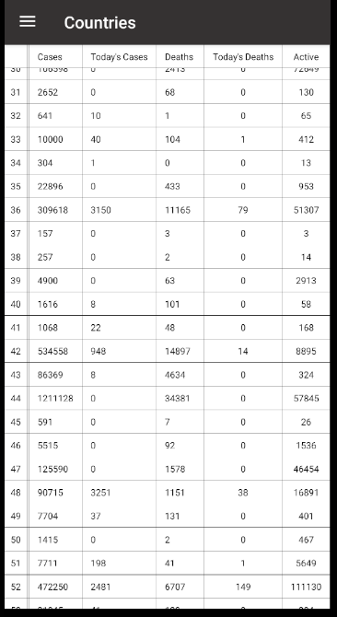
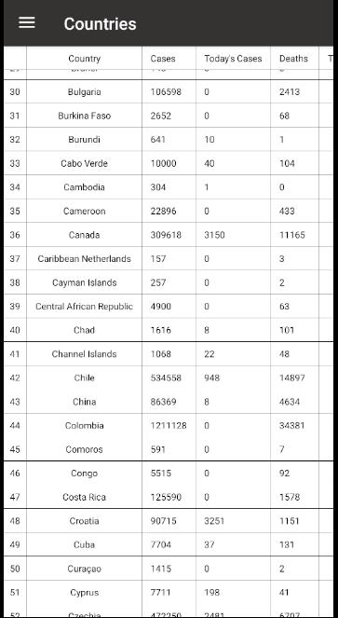
Storage
Each time the live data is pulled from the APIs, it will be stored in a table and updated each time the user refreshed the application.

Slide 13

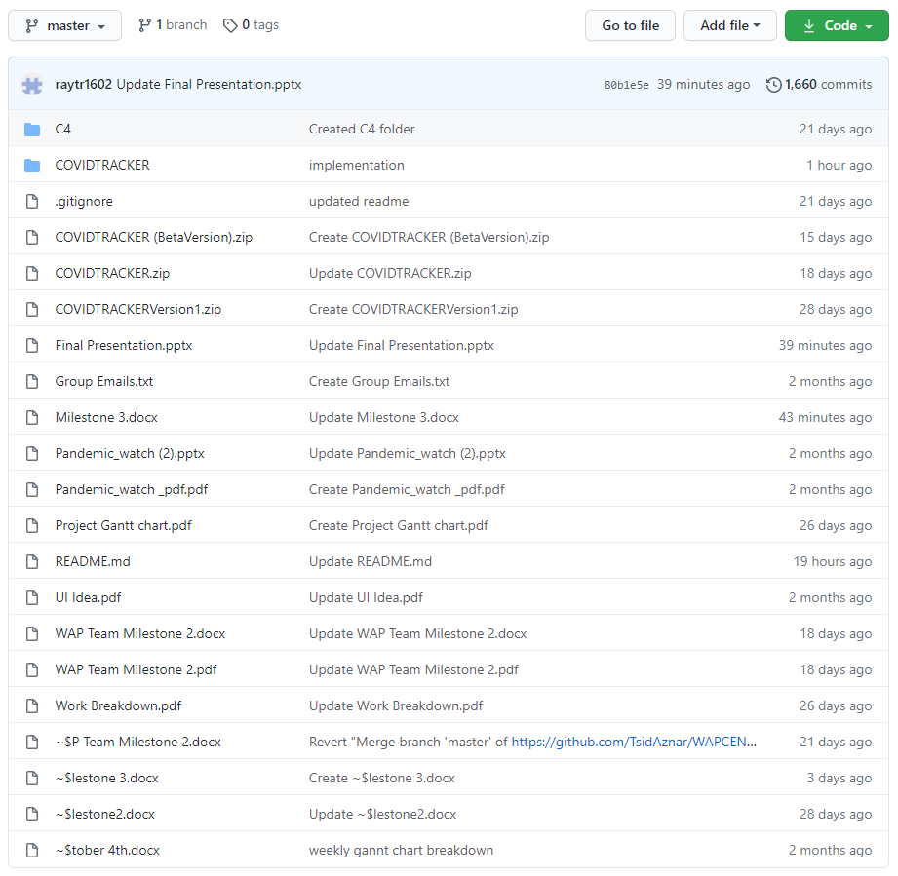



GitHub Repository https://github.com/TsidAznar/WAPCENG319

Slide 14

GitHub Repository
https://github.com/TsidAznar/WAPCENG319
Use of GitHub Desktop to push/pull files to repository.
Code Commitments was done from Android Studio using the buttons shown below.
Blue to update project from other commits done outside.
Green to push and commit to repository and update on GitHub.

Slide 15
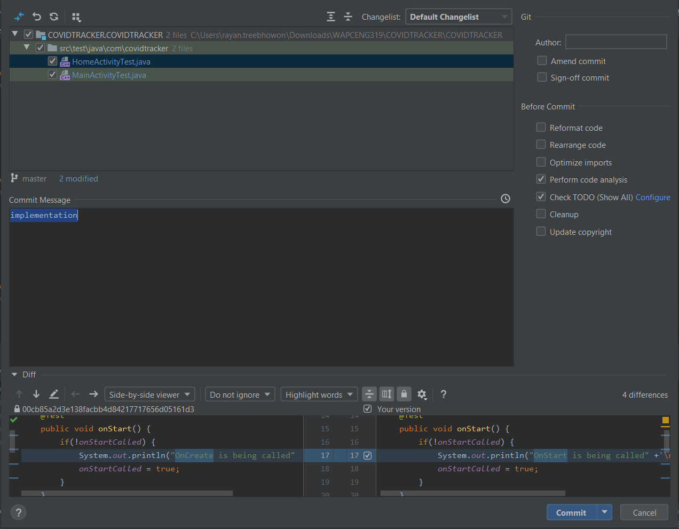
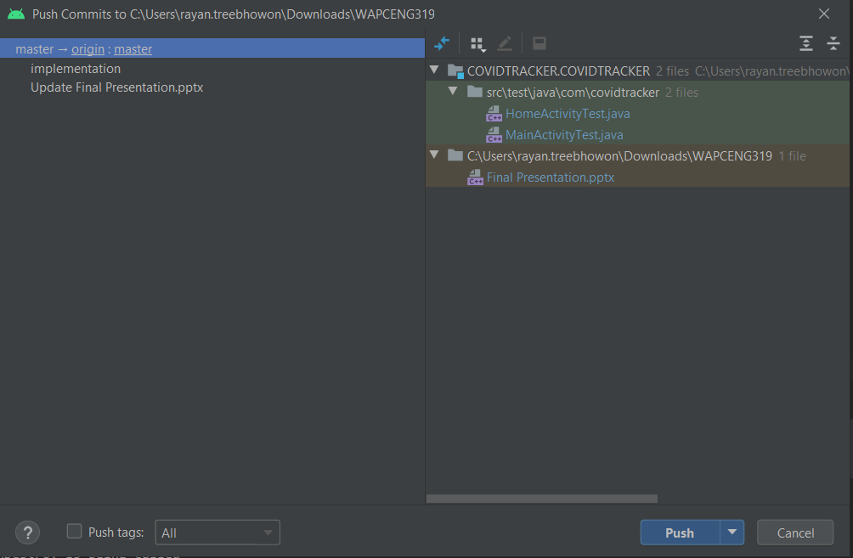
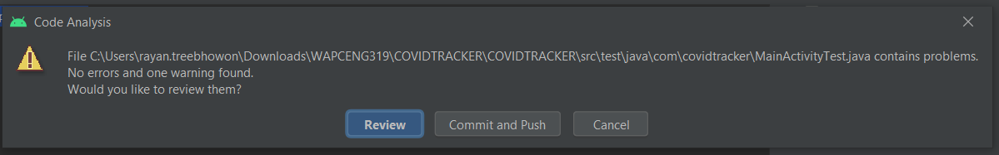
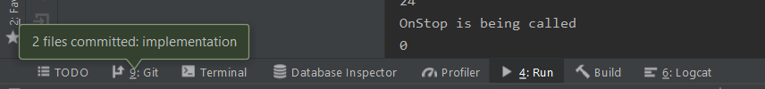
GitHub Repository

Slide 16
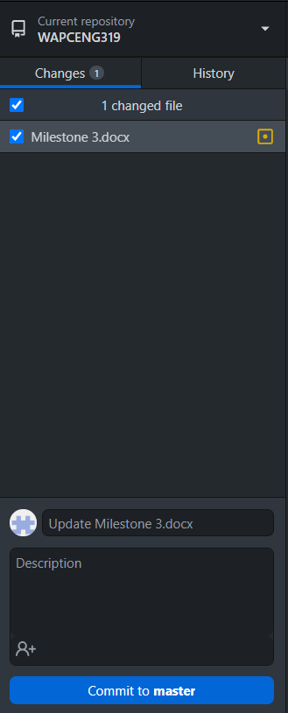
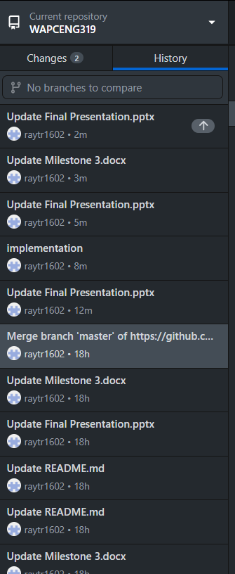
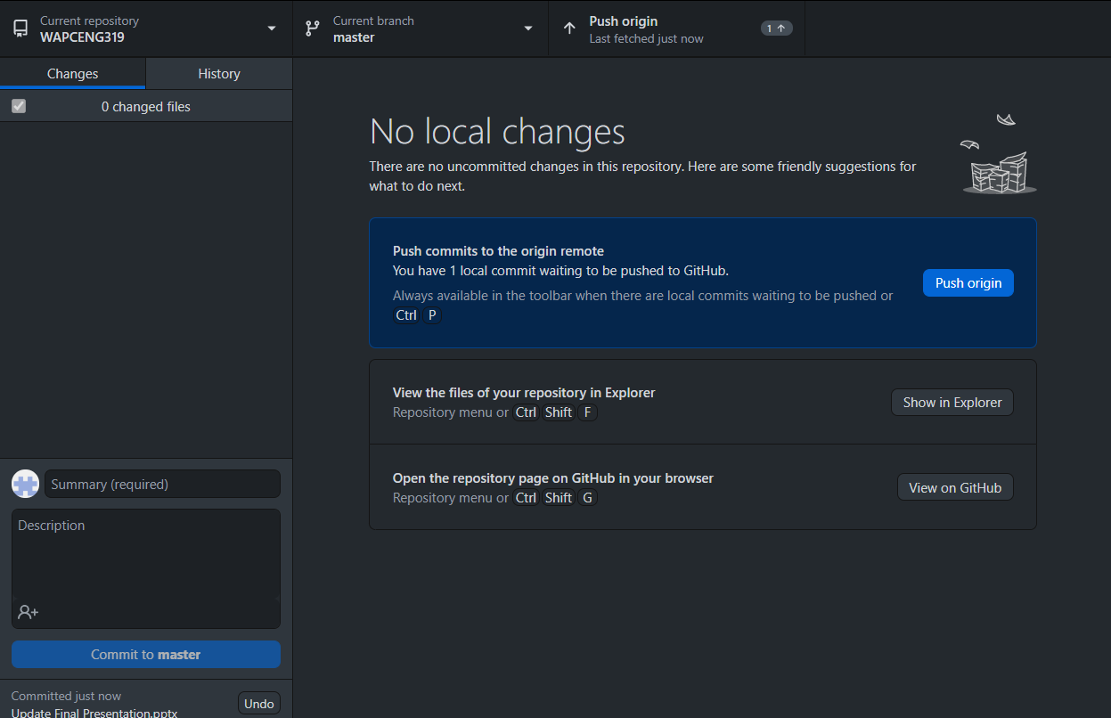
GitHub Repository
After committing we will have to push to the origin which is the repository in order to update and for the others to pull from origin to get updated file.

Slide 17
The End
Thank you for your attention!
Any Questions?

